Slide 1
Barber Stop 09/01/2019
A project by team:
”well Groomed”

Slide 2
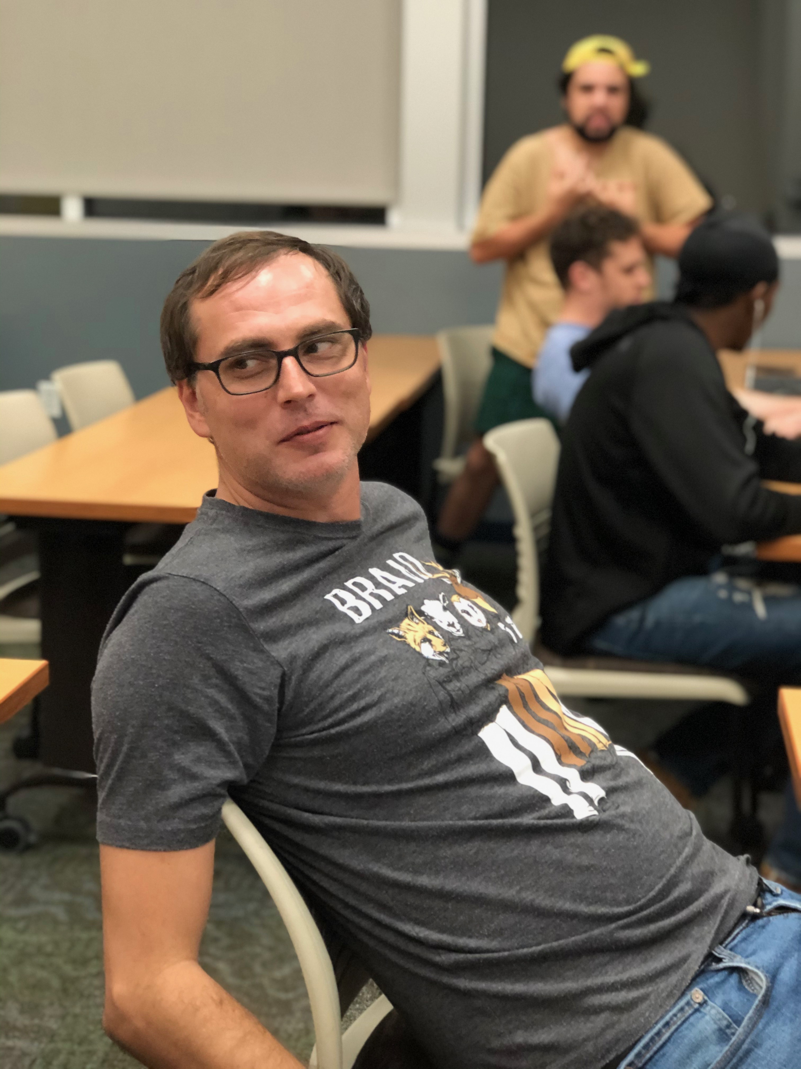
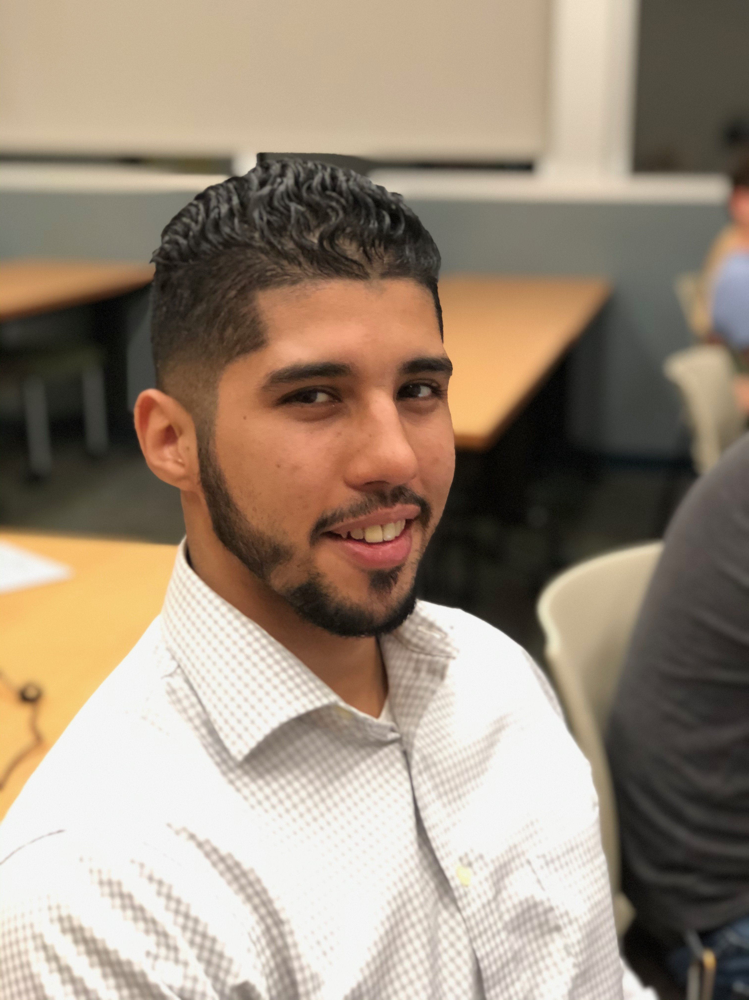
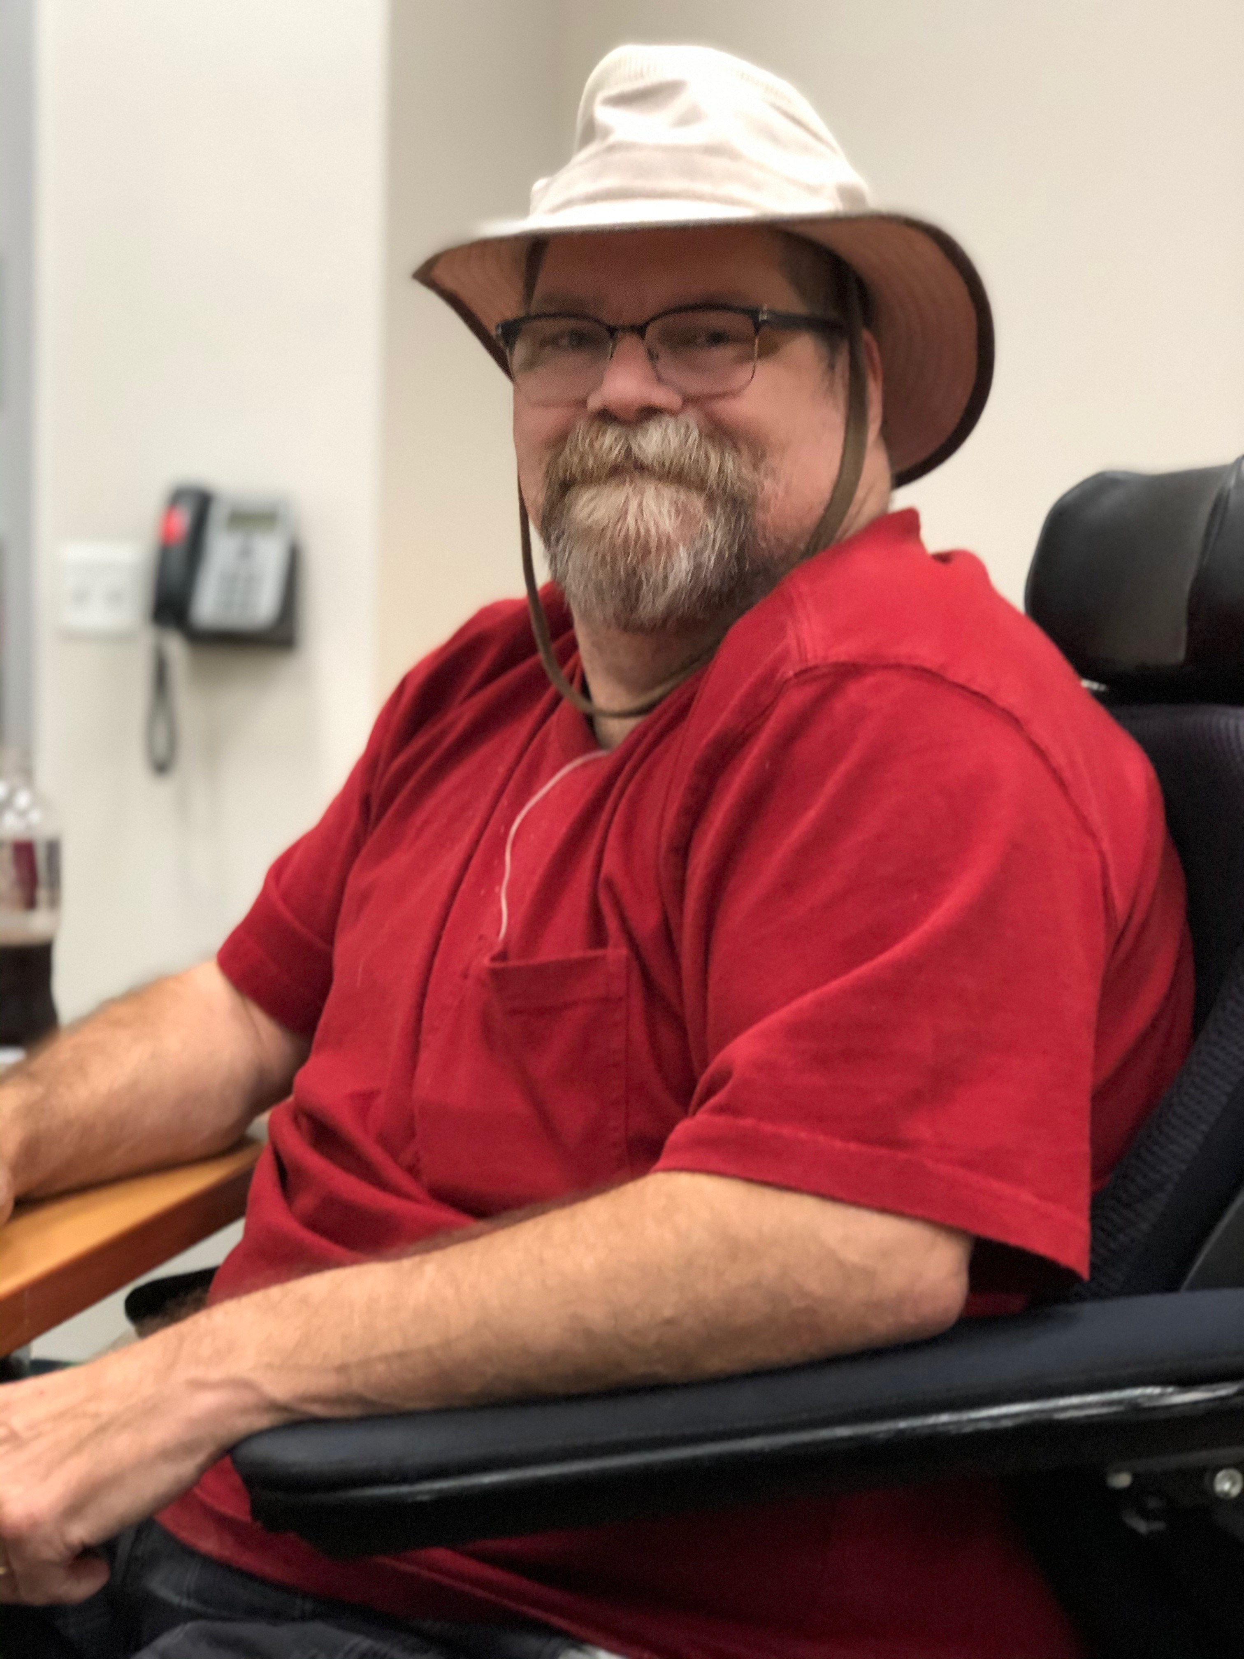
team verb 1.come together as a team to achieve a common goal:"he teamed up with the band to produce the album"synonymsjoin (up), join forces, collaborate,
Scott, “a musician, dad, and aspiring web guru”
Jed, senior team member and fast mover”
Anthony, “Program Manager and I work in BOM engineering at work. I like to play video games and sports and engoy a nap too….”

Slide 3
Barber Stop concept:
A website where a user enters:
Name:,
Location:,
Phone Number:,
User Name:,
The site returns to the user:
List of shops near the user:,
(potentially: reviews, website links, coupons/discounts)
An annotated map of the area:,
The site retains data on:
User history:,
Search history:,
Site statistic:,

Slide 4
Barber Stop User Stories:
- As a Basic user I want:
- A haircut
- Convenient location
- Fair Price
- As a Intermediate user I want:
- Styled haircut
- Basic Grooming
- Fair Price
- Convenient location
All Users may want:
- Map
- Reviews print/online
- Discount/Coupons
- As a Special occasion user I want:
- Shampoo
- Shave or Beard Style
- Hot and Cold Towles
- Manicure
- Massage

Slide 5
Resources to utilized (so far…):
HTML 5
CSS 3
Bootstrap.js
Jquery.js
Firebase.app
Firebase.database
Api keys and data returns.JSON from Yelp and Mapbox

Slide 6
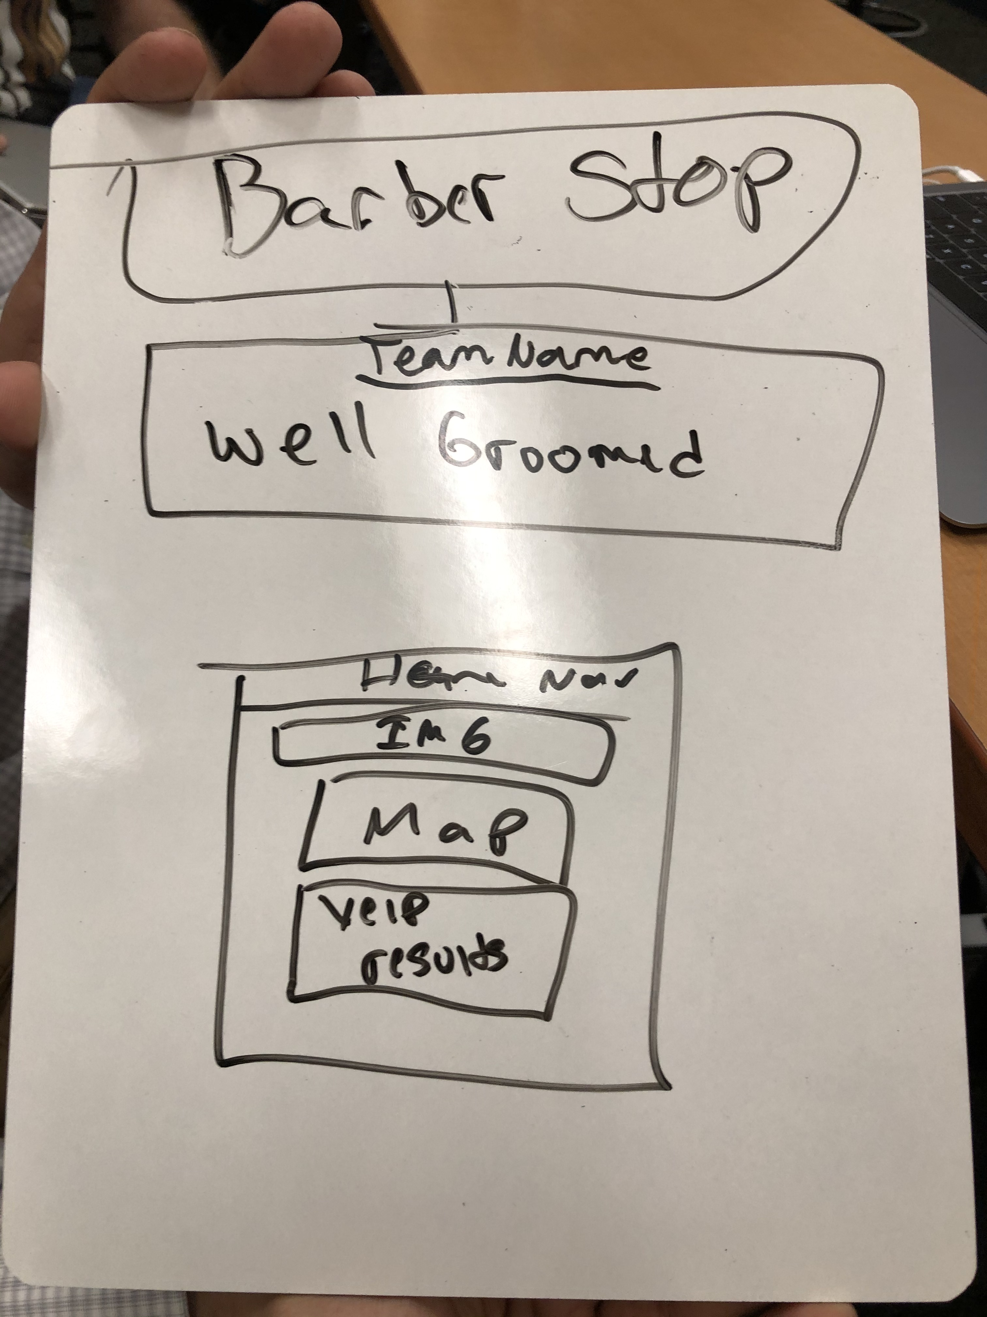
Wireframe concept: (

